Slide 1

CPM – Compounded Pharmaceutical
A system that lets you buy drugs at cheaper cost
Ketan Malik
NUID - 001378783

Slide 2
Problem Statement
To design a system that can address the issue of ever-rising prices of medicines in USA
The main reason due to which the medicines are priced at such high rates is monopoly pricing
The U.S. government grants pharmaceutical companies a monopoly on brand-name drugs
But monopolies are only causing the prices to rise excessively

Slide 3
Solution
Introduce a Compounded Pharmacy Enterprise which will replace the role of drug manufacturers for consumers
Compounded Pharmacy Enterprise bridges the gap between drug manufacturers and consumers.
The traditional role of compounding pharmacies is to make drugs prescribed by doctors for specific need of the patients. These needs are generally not met by commercially available drugs
Extend the role of Compound Pharmacy to manufacture alternative drug formulations for doctors and patients at much lower cost than the commercial manufacturers
Provide a platform to doctors where they can raise a ‘research request’ to the compound pharmacy enterprise requesting to devise a suitable formulation for a medicine

Slide 4
Work Flow
Doctor
Manufacture
Research
Inspect
Deliver
Advertisement
Patient

Slide 5
Architecture
1. Ecosystem – Consists of a Network
2. Network – Consists of two enterprise
Compound Pharmacy Enterprise: Manages manufacturing/research, inspection and delivery of formulation
Marketing Enterprise: Manages advertising of newly accepted formulations and adds doctors and patients for requesting manufacturing/research
3. Compound Pharmacy Enterprise – Consists of 4 organizations
Manufacture Organization
Research Organization
Inspection Organization
Delivery Organization
4. Marketing Enterprise – Consists of 3 organizations
Advertising Organization
Doctor Organization
Patient Organization

Slide 6
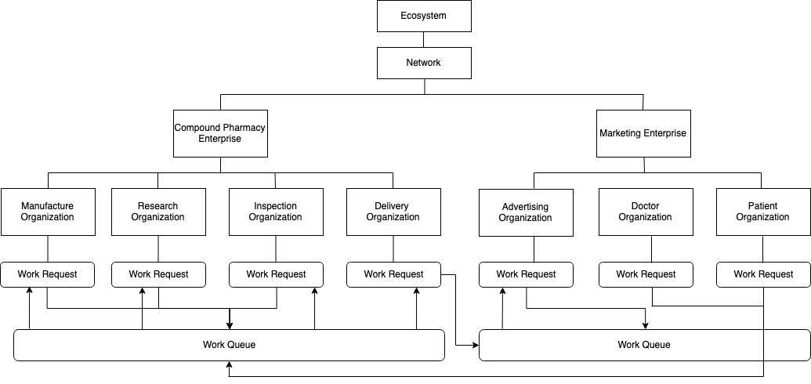

Slide 7
Application Use Cases
1. Ecosystem Admin
Create, update, view and delete network
Add and delete enterprises under network
Create employees under enterprise and provide login credentials and enterprise admin privileges
2. Enterprise Admin
Create, update and view organizations
Add employees under organizations and add their respective user accounts for providing login privileges
View following pie charts:
Employee-Organization distribution
Organization-Work Request distribution
Medicine-Manufacturing Distribution
Medicine-Research Distribution
State-wise manufacturing request
State-wise research request

Slide 8
Application Use Cases Cont..
3. Organization Employees
Doctor Role – create work request for either manufacture/research a medicine
Patient Role – create work request for manufacturing a medicine
Manufacturing Role – accept a manufacturing W.R. and process for inspection
Research Role – accept a research W.R. and process for inspection
Inspection Role – accept an inspection W.R. and either process further for delivery/advertising or send it back to manufacture/research organization if inspection test cases fails
Delivery Role – accept a delivery W.R. and process for pickup. Send SMS with pickup code to the originator once the request is processed
Advertising Role – accept an advertising W.R. and process for marketing. Once processed, an SMS is sent to originator and the medicine is made available for ordering

Slide 9
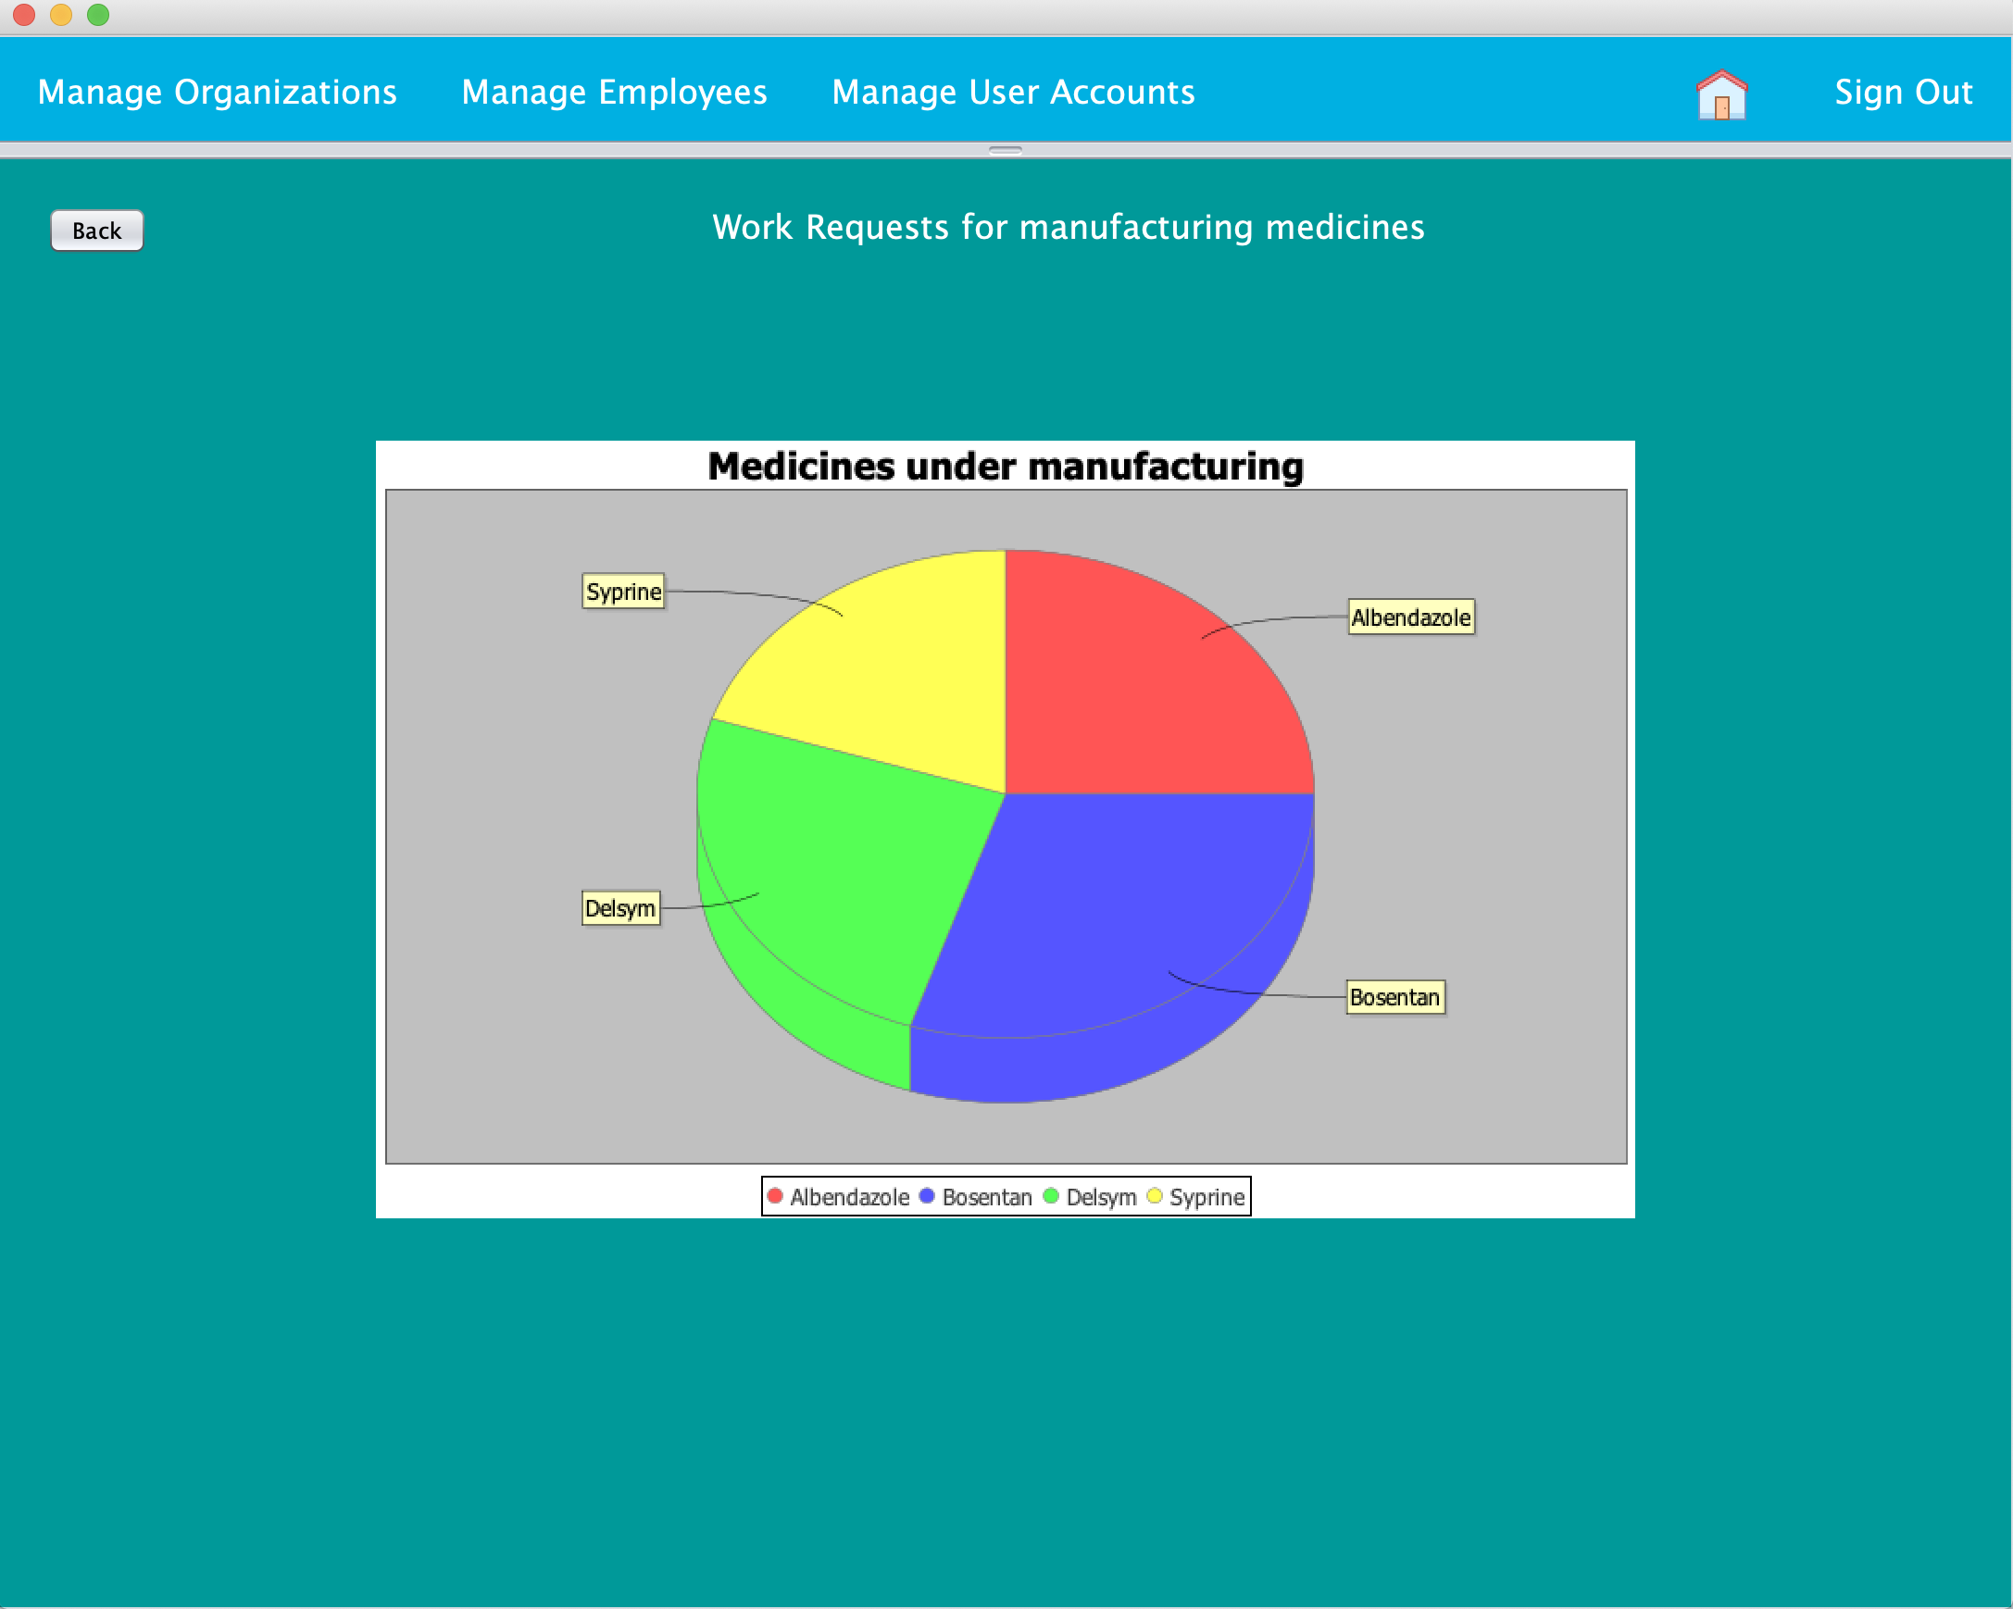
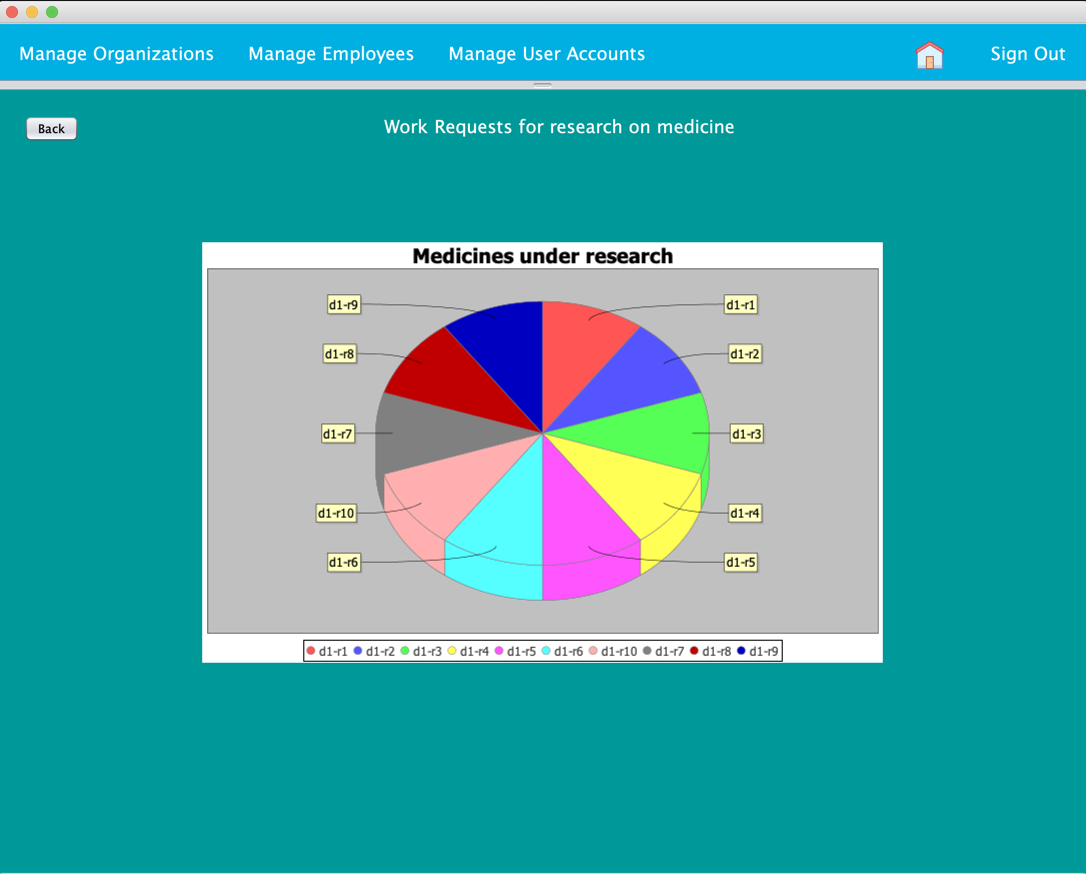
Data for Compound Pharmacy Enterprise

Slide 10
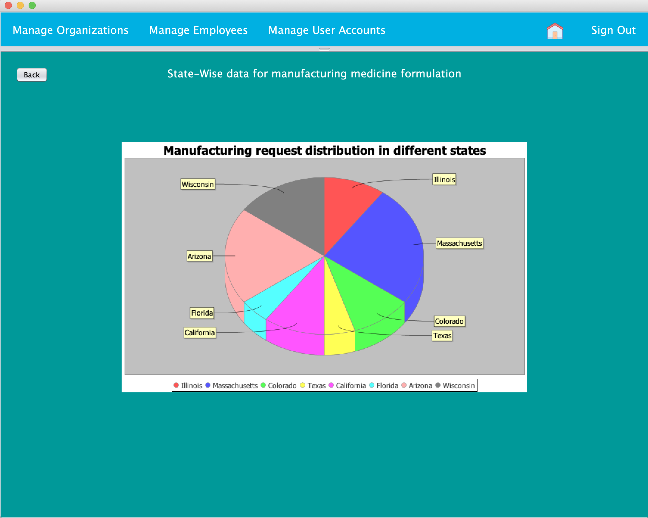
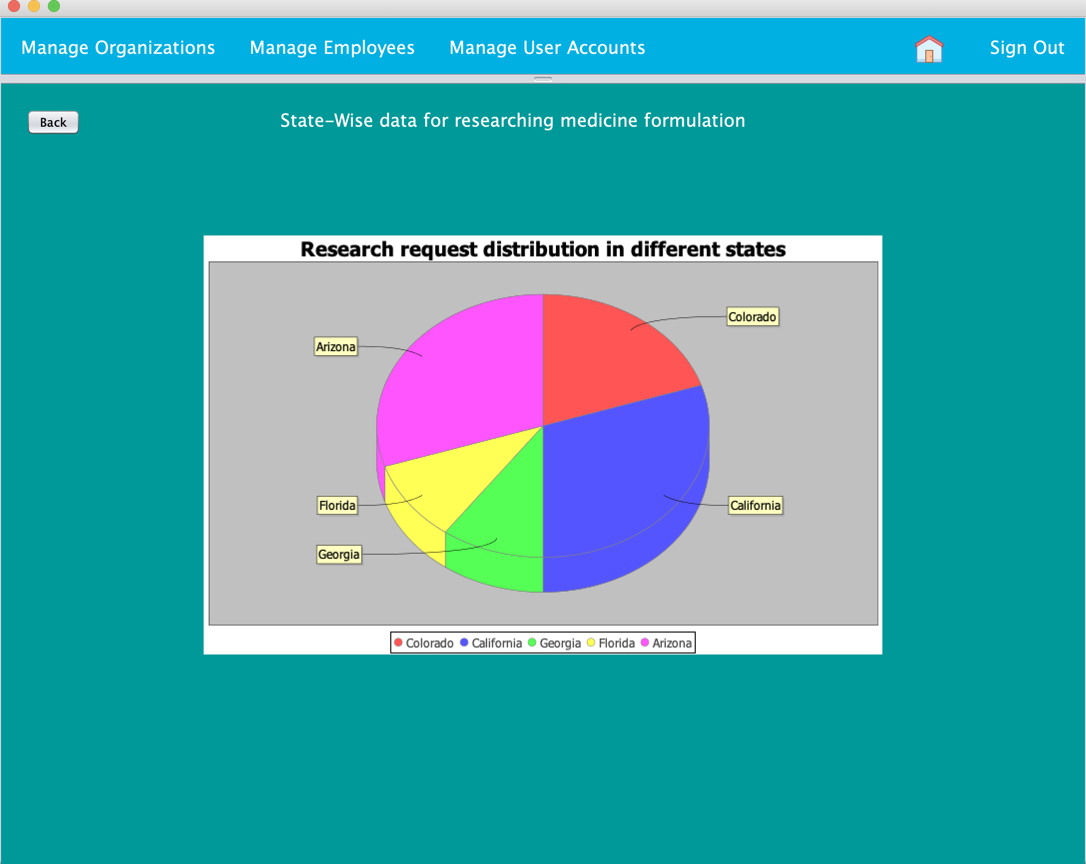
Data for Marketing Enterprise

Slide 11
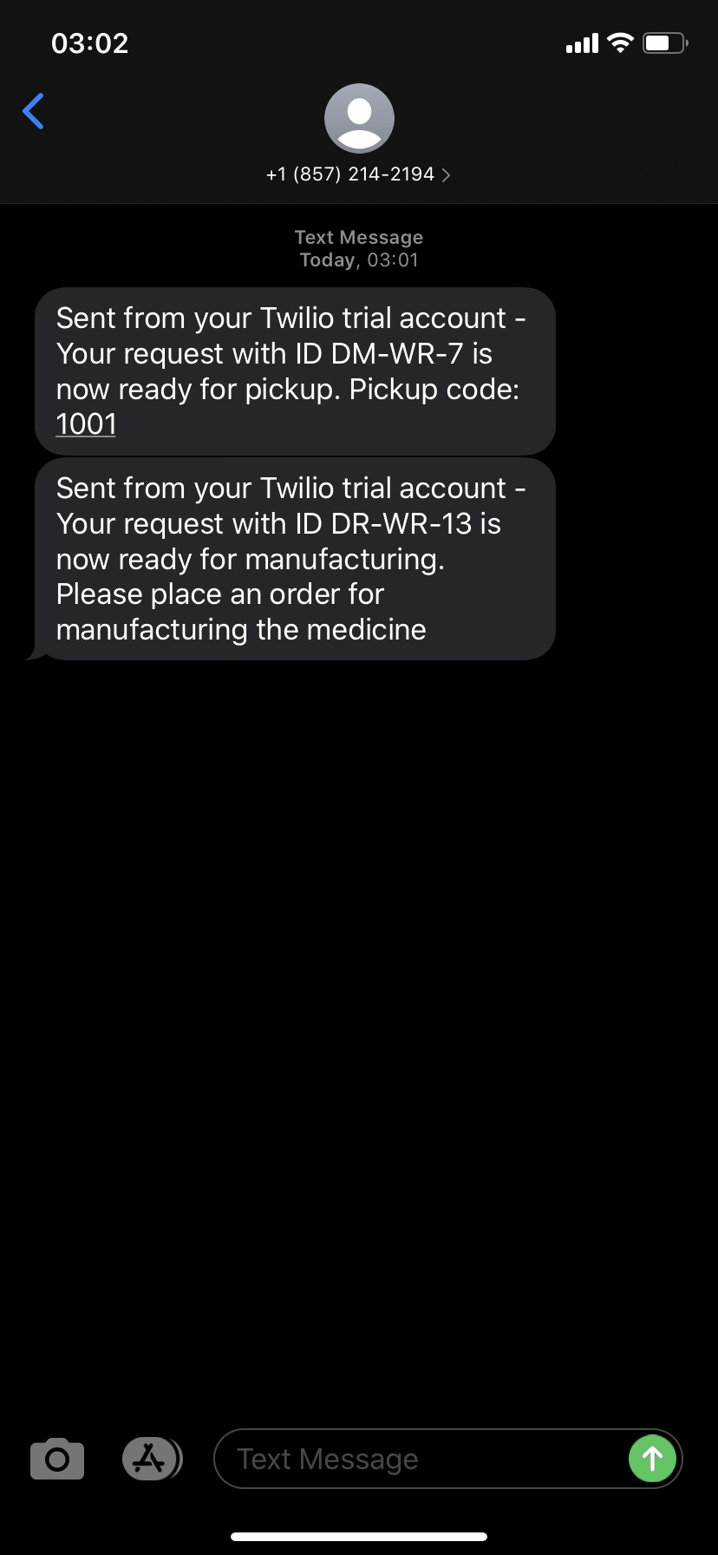
SMS Updates

Slide 12
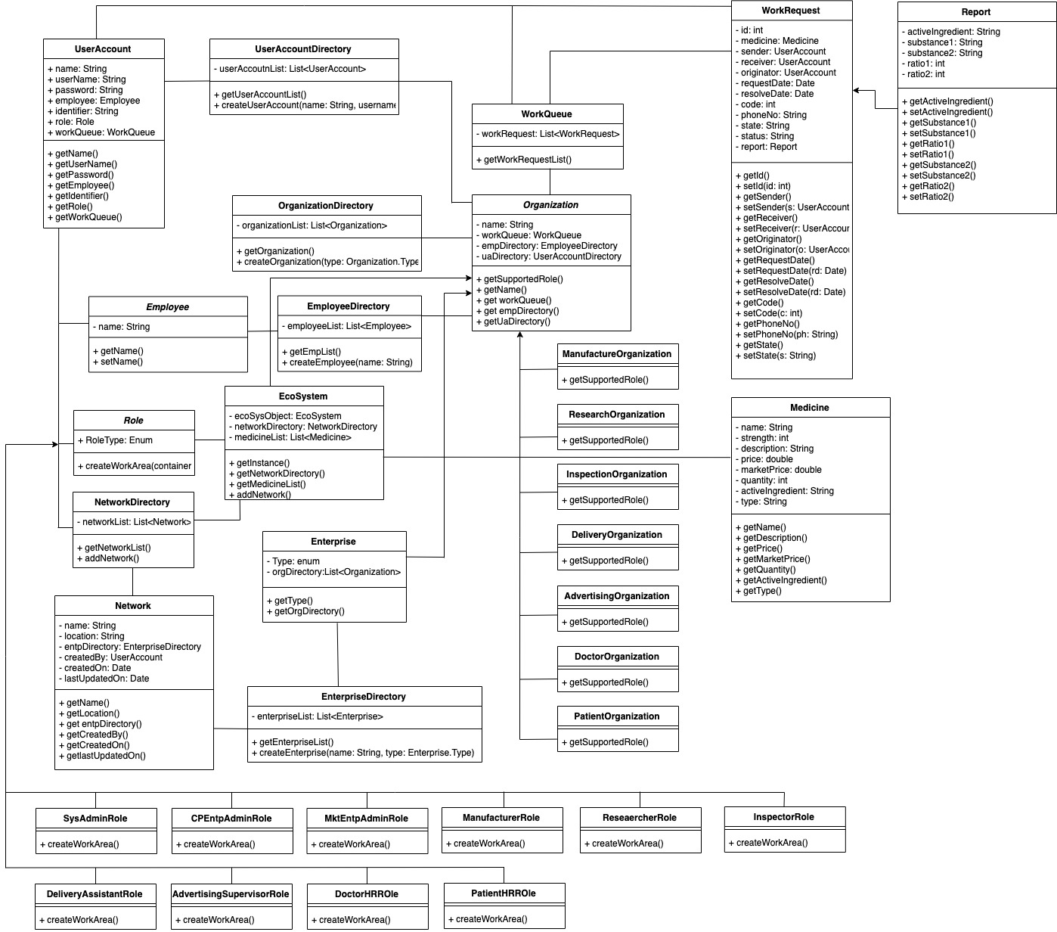
Class Diagram

